Slide 1
Finding The Right Bud
EDA 1 - 2023 Todd Garner & Lani Lewis SMU

Slide 2
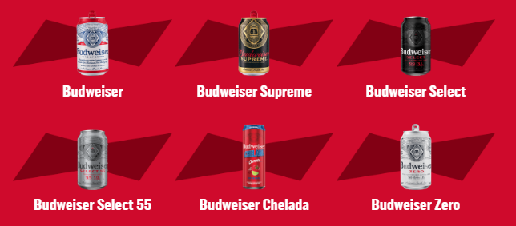
Budweiser Beer
“Budweiser is a medium-bodied, flavorful, crips American-style lager.”
5% Alcohol by Volume (ABV)
12% International Bitterness Units (IBU)
https://us.budweiser.com/
https://worldfood.guide/list/list_of_beers_in_america_by_alcohol_content_abv/

Slide 3
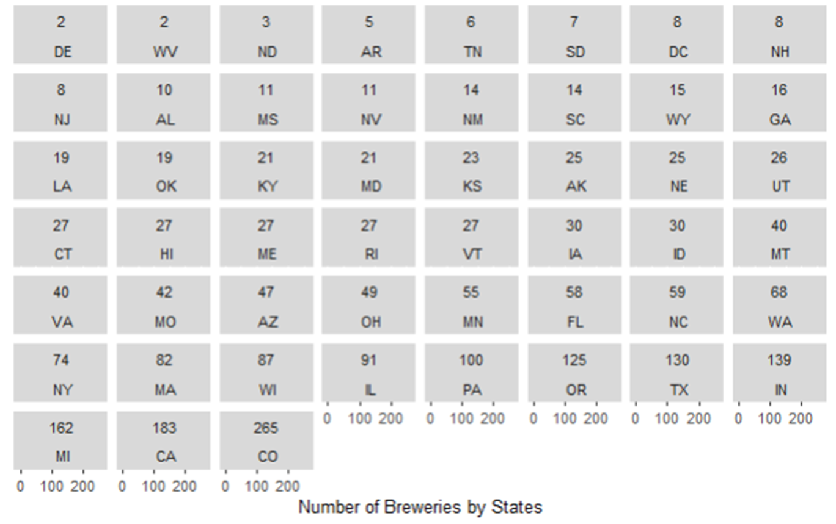
Understanding State Expansion

Slide 4
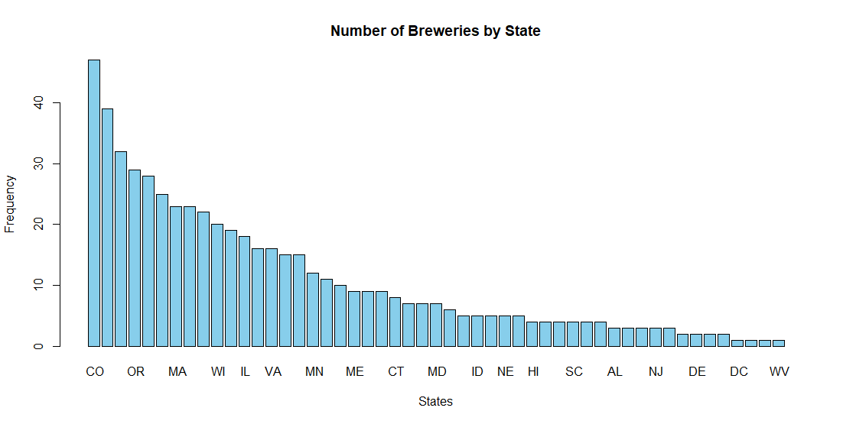
Breweries by State

Slide 5
ADDRESSING THE MISSING DATA
1005 missing IBU values – 2,410 total data observations:
"IBUs are really interesting, but for the most part, we try not to emphasize them too much in anything consumer-facing,” said Gonzalez. “It’s not really relevant to your enjoyment of the product, and we’re constantly hearing about IBUs across the industry being used an important stat when describing beer. Stone uses IBUs as an important quality control too, like most breweries, and while the consumer certainly wants to see it, we’re not making new beers to hit a certain IBU threshold.”
Conclusion: IBU is important for Brewers, but not particularly relevant to the consumer.
Result: I’ve taken the MEDIAN of the data set and inserted that value in the missing data so as not to skew the data averages.

Slide 6
ADDRESSING THE MISSING DATA
Missing values ABV: 62 values out of 2,410 observations.
2.5% of the data is missing
Conclusion: likely randomly missing data.
Result: Given extended time, determine what the values are by looking on company web sites.
Temp Solution: Set them equal to the MEDIAN of the data present

Slide 7








Colorado Beer History

Slide 8
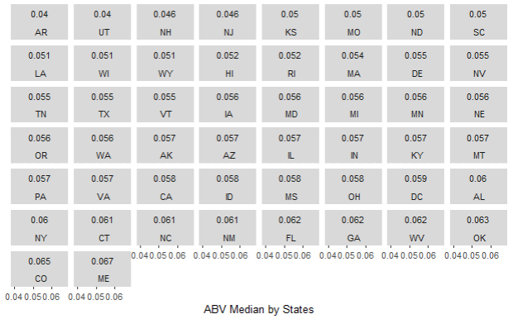
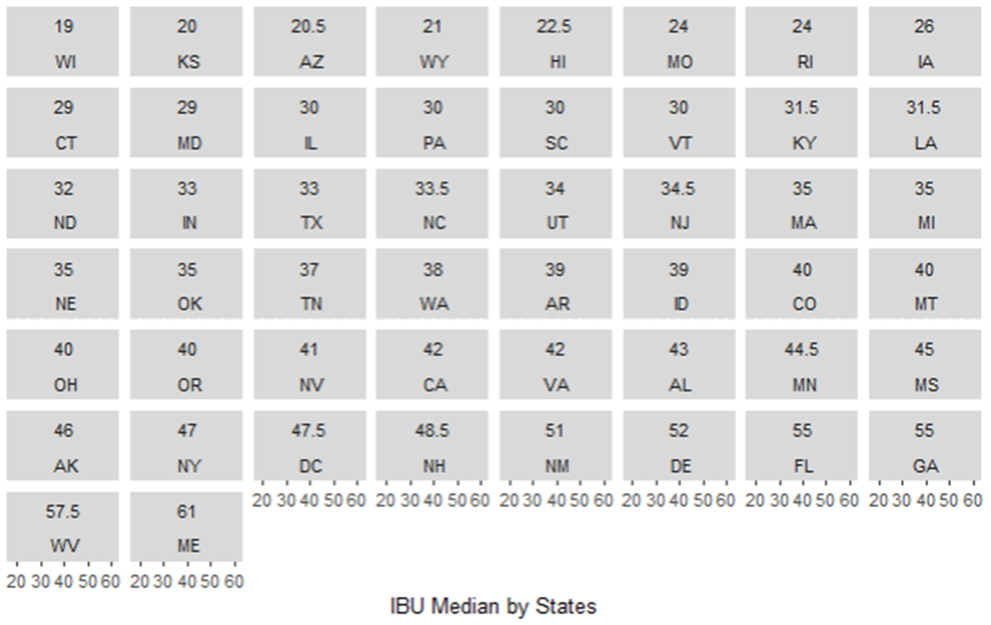
Maine Highest ABV or IBU Median

Slide 9
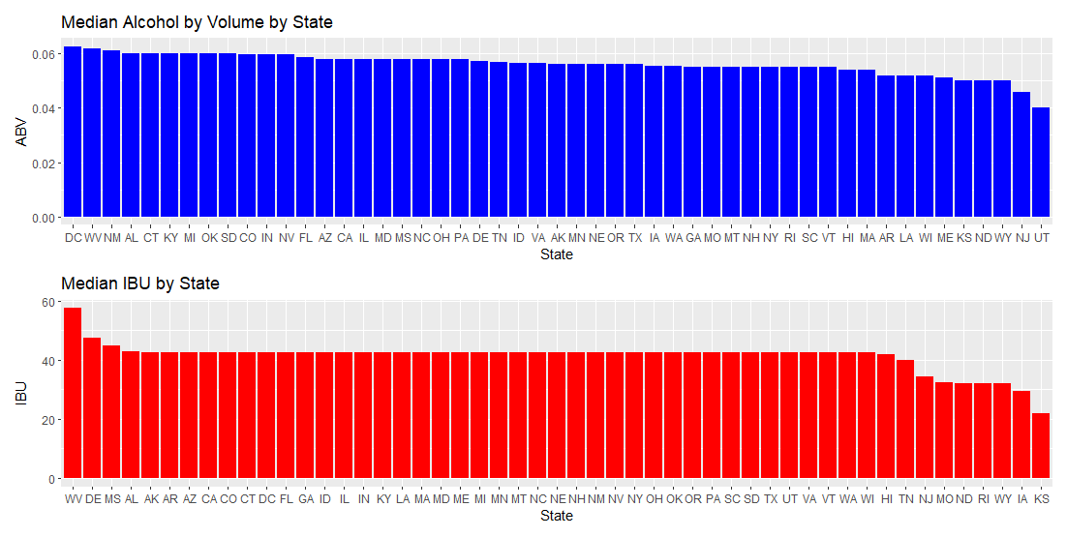
MEDIAN VALUES FOR ABV & IBU BY STATE

Slide 10
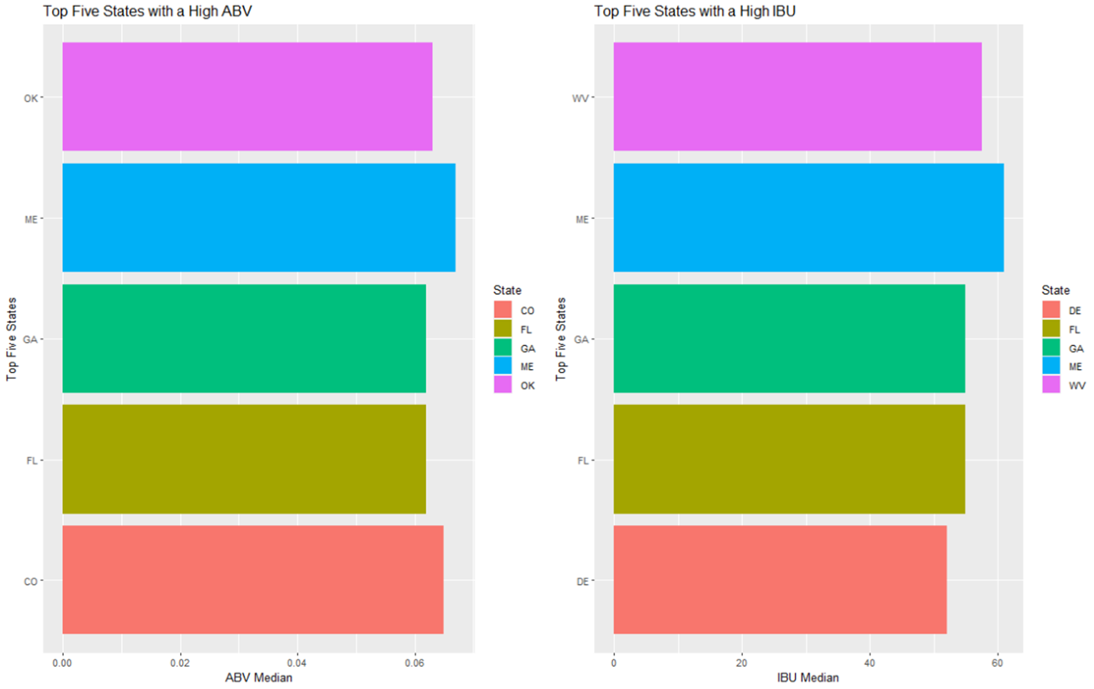
Top Five States by ABV or IBU

Slide 11
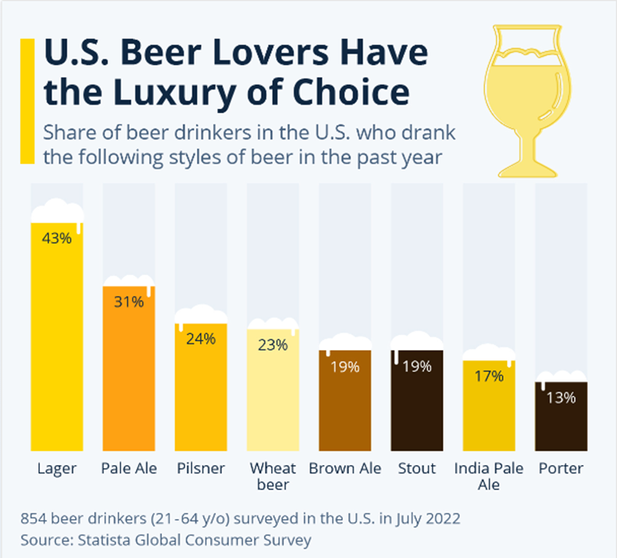
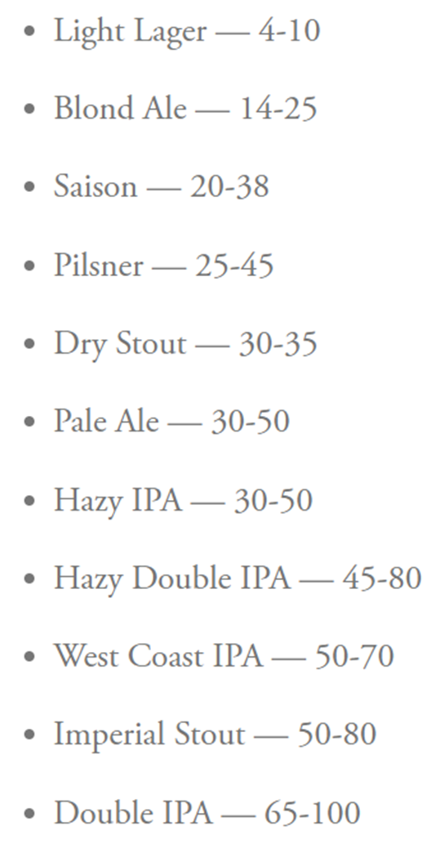
US Beer Type of Choice
IBU By Beer Type
https://www.statista.com/chart/28572/popularity-of-beer-styles-in-the-us/
https://www.firestonebeer.com/what-really-is-ibu/

Slide 12
MAX ABV & MAX IBU
MAX ABV: 52 Lee Hill Series Vol. 5 - 12.8% ABV Boulder , CO
MOST BITTER: 375 Bitter Bitch Imperial IPA 138 IBU Astoria OR

Slide 13
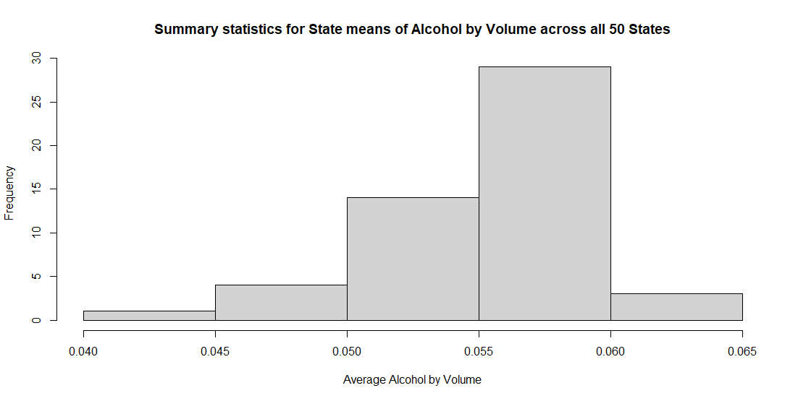
Summary Statistics and Distribution by ABV
Comments on summary statistics and distribution Alcohol by volume for beers – not grouped
MIN: 0.10%
MAX: 12.8%
MEAN: 5.977%
MEDIAN: 5.7%

Slide 14
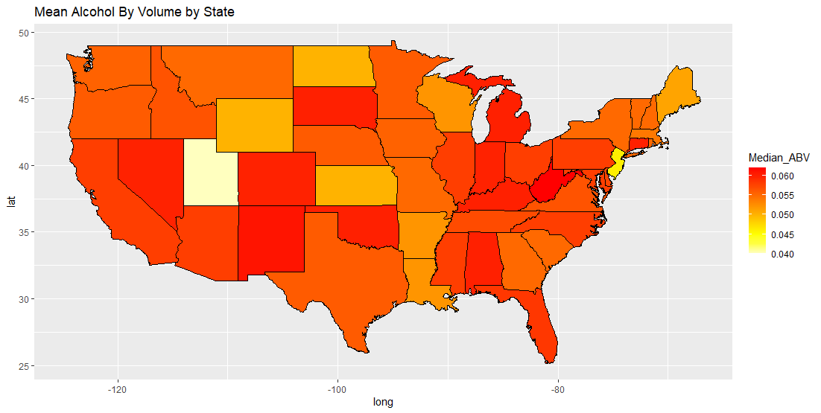
Mean Alcohol by Volume by State

Slide 15
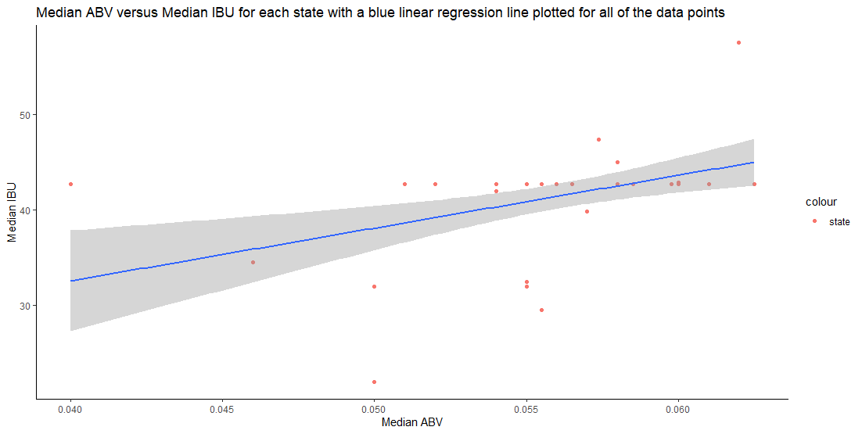
Relationship between ABV & IBU

Slide 16
Thank You For Your Business!
Lani Lewis & Todd Garner
DS 6306 Case Study 1 - EDA

